Slide 1
The Timeline of Groucho-Dependent Gene Expression in the Drosophila Embryo
Michael Chambers
Albert Courey Lab
March 2014

Slide 2
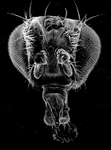
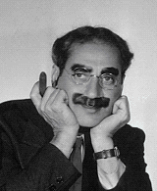
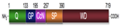
Groucho (Gro) Groucho Marx
groucho¹
groucho^{Marx}
groucho mutant results in extra supraorbital bristles
Gro
R
A
OFF
CRM

Slide 3
Gro mediates repression via interaction with DNA-bound repressor
Gro
TF
TF
Notes:
Groucho mediates long-range repression. The idea of long-range repression can be demonstrated in the following diagram. A transcription factor binds an CRM leading to a specific spatial expression pattern. An independent transcription factor binds to another enhancer element, at a distance of greater than 1 kb, and leads to a different specific spatial expression pattern. If Gro is recruited by one of these transcription factors, it can lead to the repression of all enhancer elements driving expression of the gene. This is in contrast to short-range repressors that mediate repression of single enhancer elements over a few hundred bps.

Slide 4
Gro mediates repression via interaction with DNA-bound repressor
Gro
TF
TF

Slide 5
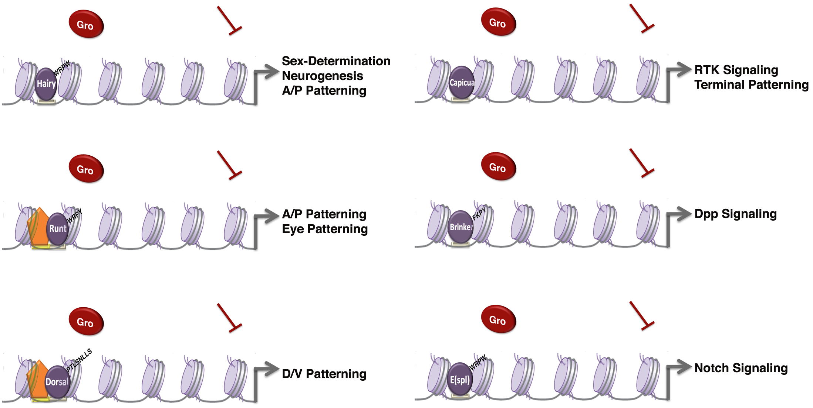
Groucho is required by many different DNA-bound repressors
image courtesy Wiam Turki-Judeh

Slide 6
There is evidence for multiple mechanisms of Gro mediated repression
Turki-Judeh and Courey, 2012
Notes:
Mention chromatin condensation
----- Meeting Notes (5/30/13 12:52) -----
Title: There is evidence for multiple mechanisms of Gro mediated repression
----- Meeting Notes (3/19/14 14:01) -----
Long range vs short range repression

Slide 7
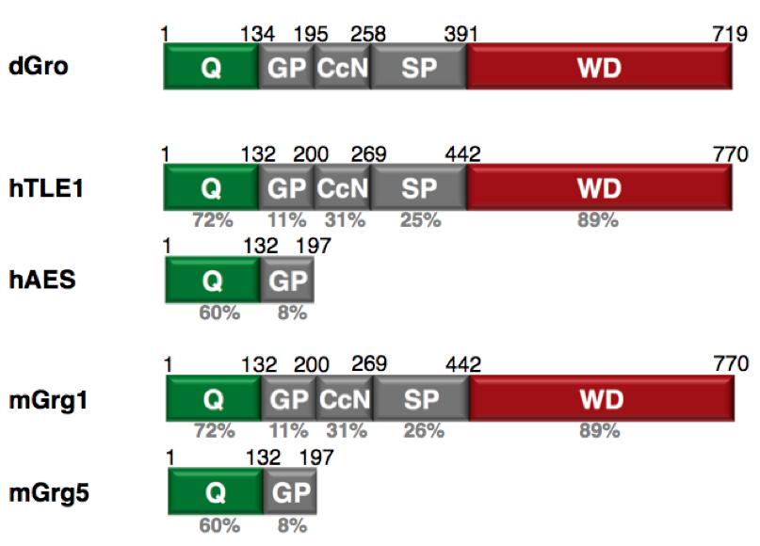
Groucho/TLE family proteins are highly conserved throughout metazoans
Oligomerization
Regulation
Protein interaction
Repressor Interaction
image courtesy Wiam Turki-Judeh
Notes:
----- Meeting Notes (5/30/13 12:52) -----
XTitle: Groucho is conserved throughout metazoans

Slide 8
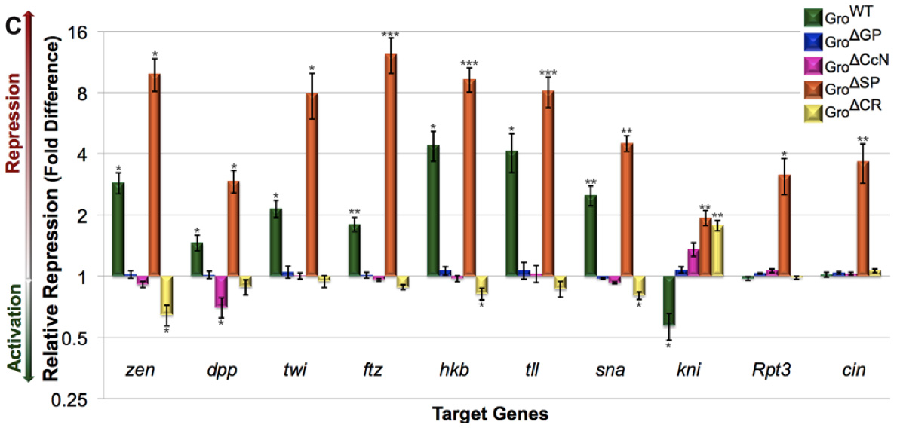
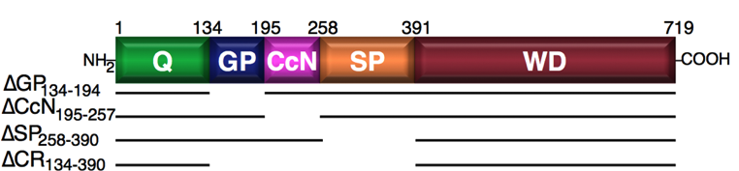
The central regions of Gro have roles in repression, Gro down-regulation, and target specificity
Turki-Judeh and Courey, 2012
Notes:
Point out repressor of repressors (knirps is repressed by tailless, which is repressed by Gro)
dSP potentially makes Gro a promiscuous activator, as it represses knirps, a non-target gene, as well as its regulator tll)
Applying this sort of analysis genome wide required the use of RNA-seq
0-3 hr embryos
----- Meeting Notes (5/30/13 12:52) -----
function -> repression
Smaller graph
Show diagram of mutations (or on previous slide)
Be sure to describe experiment before results

Slide 9


Genomic scale analysis will provide significant insight into Groucho’s functions in early fly development
Embryo
24 hr
Larva
4 days
Pupae
5 days
Adult
RNA-seq
Nascent-seq
Chip-seq
mRNA accumulation
mRNA transcription rate
Groucho binding
Histone modifications
Notes:
----- Meeting Notes (5/30/13 12:52) -----
Genome-wide instead of genomic scale
24 hr embryogenesis
Pupal 5 days ?
Histone marks under chip-seq

Slide 10
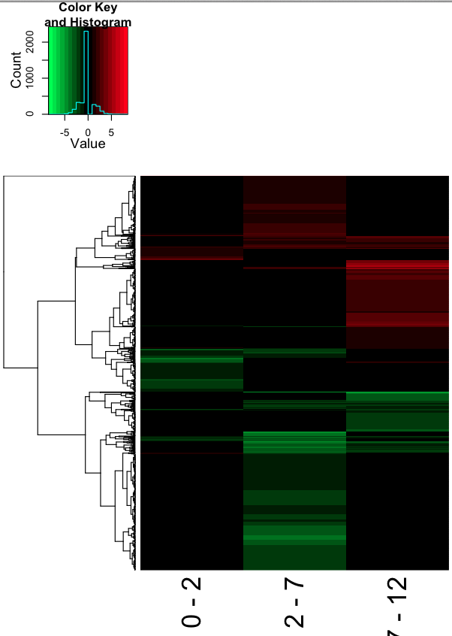
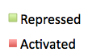
Gro regulates numerous genes throughout early development
0-2 hr
2-7 hr
7-12 hr
Notes:
Sub-titles?
Add heatmap
Table of total activated/repressed genes at all timepoints
Clarify heatmap
Only contains genes regulated at one or more timepoint ( a minority of genes %?)
Each line is a gene
Potentially split heatmap into different classes? Lose clustering dendrogram
Majority of affected genes are repressed. Some are activated. Some evidence that Gro/TLE family proteins can serve as activators (TLE3 in humans)
To discriminate between these two possiblities, we delved into available chip-chip data
----- Meeting Notes (5/30/13 12:52) -----
Change colors
2-fold change in expression
Very conservative (many false-negatives)
----- Meeting Notes (3/19/14 14:01) -----
Early vs later experiments (timepoint changes)
Experimental outline (timepoints and chip-seq/nascent-seq relations)

Slide 11
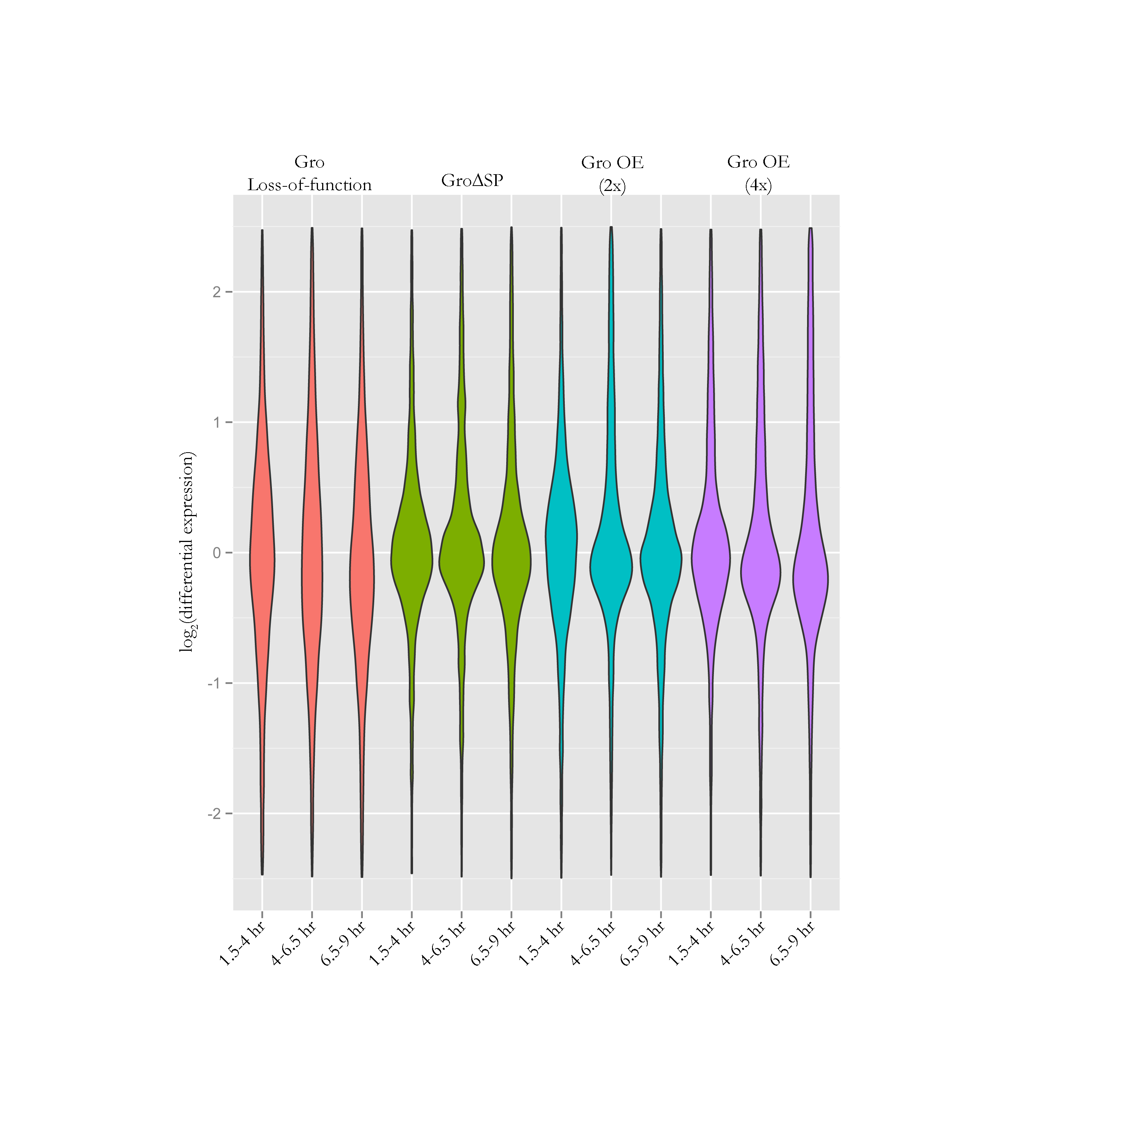
Overexpression lines show similar patterns of differentially expressed genes
Notes:
----- Meeting Notes (3/19/14 14:01) -----
Groucho domain slide and Wiam's results (lack of specificity)

Slide 12
The differential expression of Gro targets is largely in agreement with RT-PCR data

Slide 13
Loss-of-function leads to perturbed gene expression of Gro targets at all timepoints

Slide 14
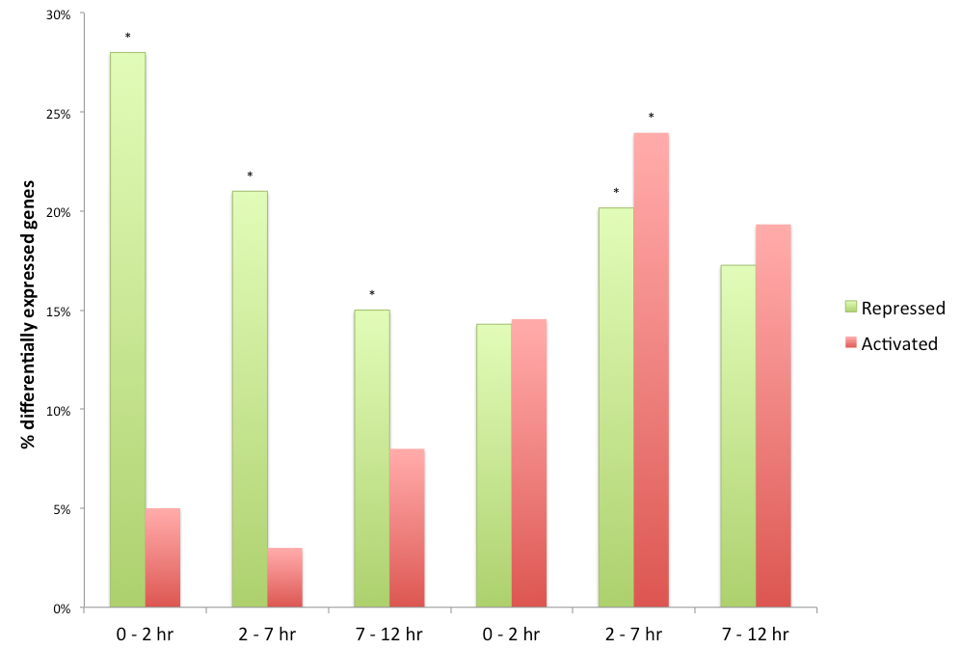
A significant number of repressed genes are associated with known Gro interactors
Dorsal
Rpd3 (HDAC1)
* p-value ≤ 0.0005
Notes:
Add asterisks
----- Meeting Notes (5/30/13 12:52) -----
p-values
Title:
Rpd3/HDAC1

Slide 15
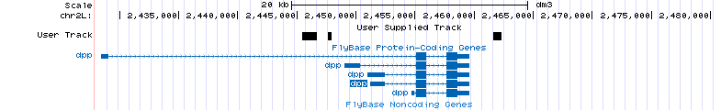
Repressed genes significantly correlate with Gro bound genes at all timepoints
Notes:
----- Meeting Notes (5/30/13 12:52) -----
Human TLE3 paper could be interesting, devote some to that paper possibly
Fix title
Slide showing where the data comes from for Gro bound genes. One figure from Clint's thesis possibly (Venn diagram) 0-12 hr embryos
Better results with same temporally staged embryos
----- Meeting Notes (3/19/14 14:01) -----
Mention "we're" making better chip-seq data
Apparent activation may be indirect
There are groucho family proteins that do activate (so it’s interesting)

Slide 16
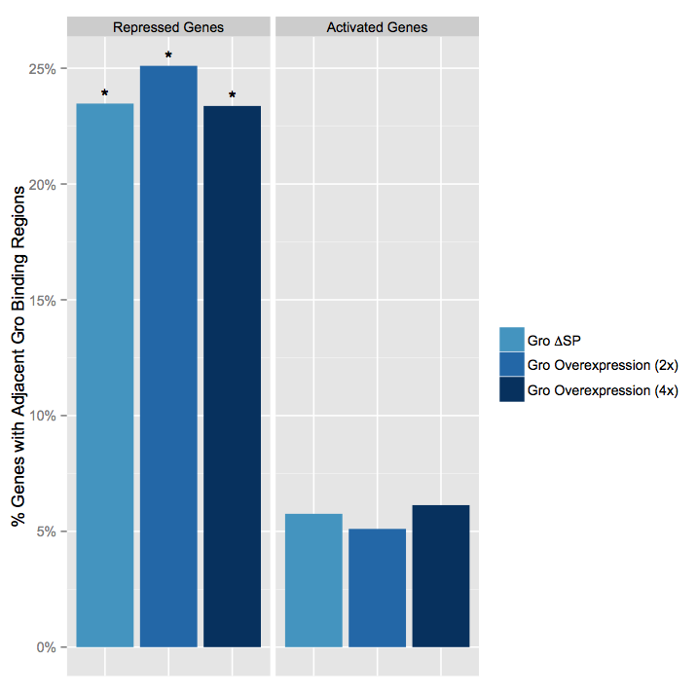
A significant number of genes repressed upon Groucho overexpression are bound by Groucho
* p-value ≤ 0.01
Notes:
----- Meeting Notes (3/19/14 14:01) -----
Remove deltaGro data

Slide 17
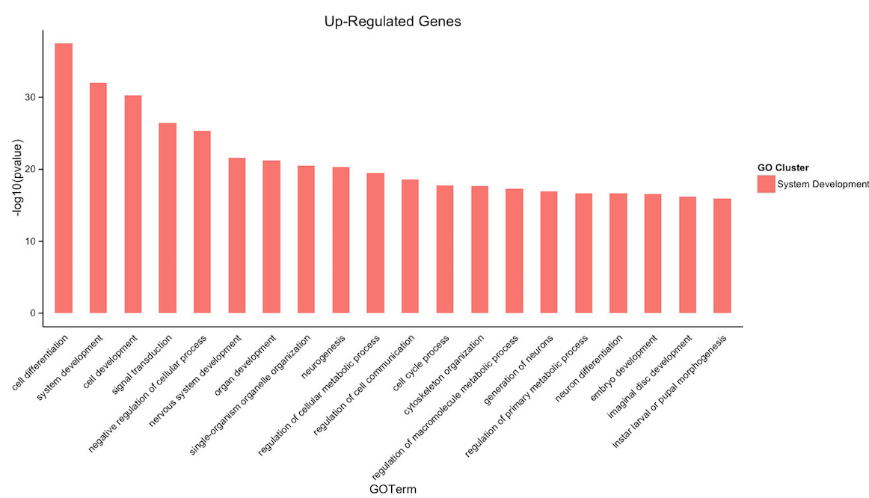
Gro repression targets are enriched for genes involved in differentiation and neurogenesis
Notes:
----- Meeting Notes (3/19/14 14:01) -----
Targets of Gro-mediated repression
Significance
Long vs short-range
Levine's results (Gro is required for ~1/2 of essential repressors in embyronic patterning)

Slide 18
Genomic scale analysis will provide significant insight into Gro’s functions in early fly development
Embryo
24 hr
Larva
4 days
Pupae
5 days
Adult
RNA-seq
Nascent-seq
Chip-seq
mRNA accumulation
mRNA transcription rate
Groucho binding
Histone modifications
Notes:
----- Meeting Notes (5/30/13 12:52) -----
Genome-wide instead of genomic scale
24 hr embryogenesis
Pupal 5 days ?
Histone marks under chip-seq

Slide 19
Nascent-seq allows direct genome-wide measurement of transcription rates
Traditional RNA-seq
- Proportional to protein level
AAAA
AAAA
AAAA
Nascent-seq
Proportional to transcription rate
Bypasses accumulation effects
Differential processing and degradation rates
AAAA
AAAA

Slide 20
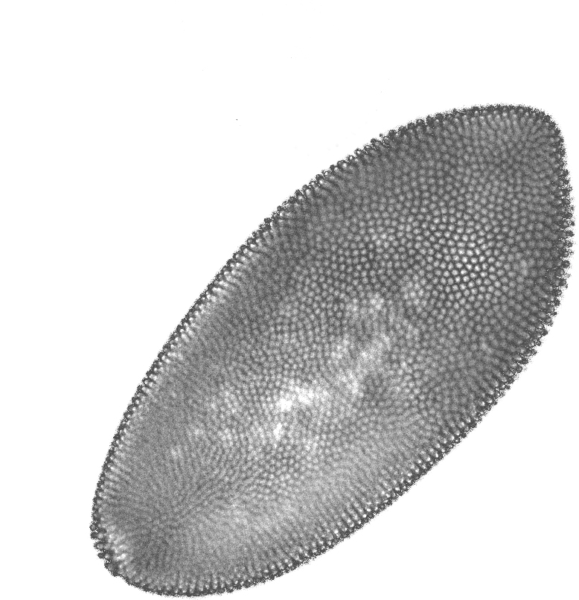
Nascent-seq augments our knowledge of Groucho’s effects on the transcriptome
WT
Nuclear lysis
Total mRNA abundances & DE genes
1.5-4 hr
Homogenization
Low-speed centrifugation
Data integration
4-6.5 hr
Filtration
TRIzol extraction/RNA isolation
Nascent mRNA abundance
6.5-9 hr
Sucrose cushion (2x)
poly-A & rRNA depletion
Traditional
RNA-seq
Notes:
Highlight importance of nascent-seq
----- Meeting Notes (5/30/13 13:03) -----
Why do in addition to RNA-seq?
Less sensitive (more embryos required)
RNA-seq loss of function (germline clone analysis)
----- Meeting Notes (3/19/14 14:01) -----
Cartoon for nascent-seq (how's it's different and what info we want from it)

Slide 21
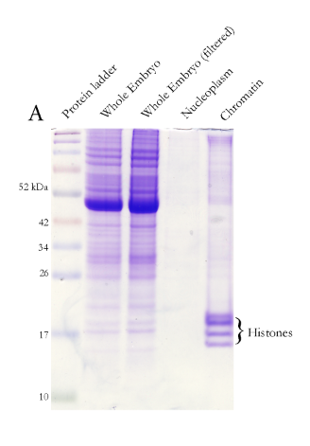
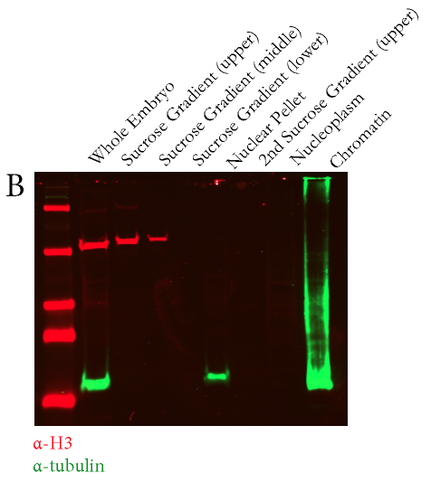
Fractionation of chromatin-associated RNA enriches for nascent RNA

Slide 22
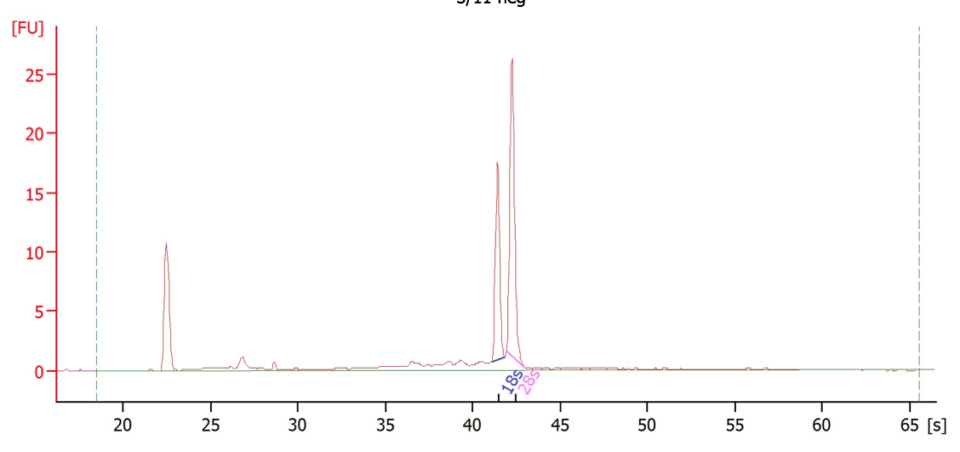
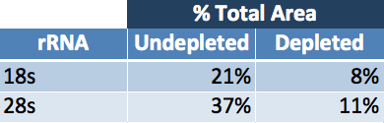
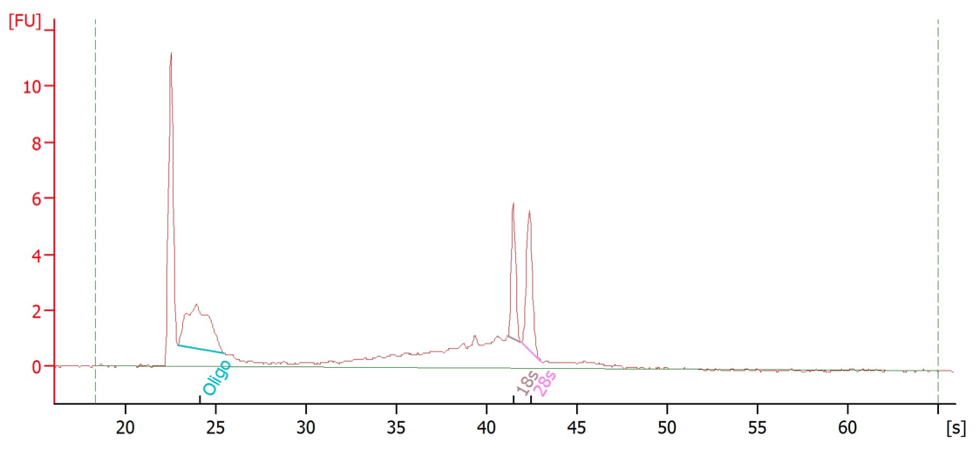
Nascent rRNA contains lower levels of rRNA than total RNA
Undepleted
Depleted
Notes:
----- Meeting Notes (3/19/14 14:01) -----
Normally do polyA selection (not appropriate for nascent RNA)
Future Directions
Conclusion / Acknowledgements

Slide 23
Future Directions
Preparation and sequencing of nascent-seq libraries
Integration of nascent-seq data with RNA-seq/differential expression data
Statistical refinement of DE calls
Time-series analyses

Slide 24
Acknowledgements
Courey Lab
Dr. Al Courey *
Wiam Turki-Judeh *
Kenny Chen *
Pak Kwong
Joseph Cao
Collaborators
Sean Gallaher (Merchant Lab)
Kelvin Zhang (Zipursky Lab)
Committee
James Bowie
Mike Carey
Cathy Clarke
Volker Hartenstein
Notes:
----- Meeting Notes (5/30/13 13:03) -----
Matteo Pellegrini
----- Meeting Notes (3/20/14 11:01) -----
5'cap RACE
5' capping
phosphatase
then
pyrophosphatase

Slide 25
Extra Slides

Slide 26
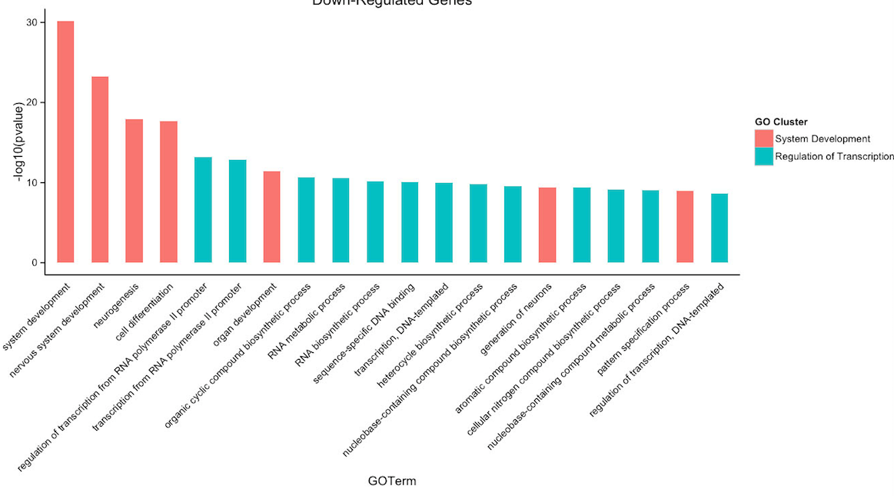
Notes:
----- Meeting Notes (3/19/14 14:01) -----
Leave out

